Slide 1
2017 yr 7 Naplan questions
The following questions are ones that our BSC 2017 yr 7 cohort had the greatest problems with compared to the national average according to the CNAP data.
Use them as you see fit (crumple and shoot, starter questions, quiz night style game).

Slide 2
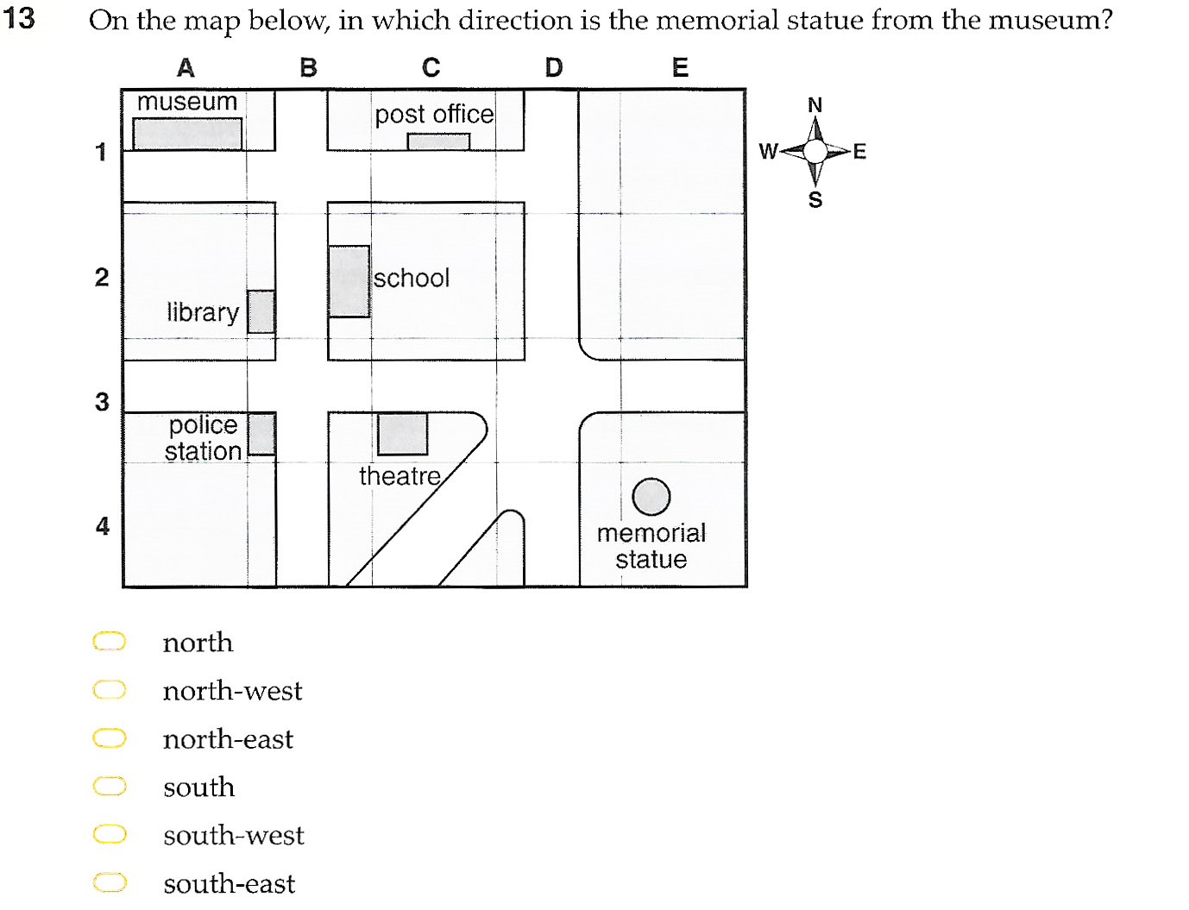
Answer = f (south-west)

Slide 3
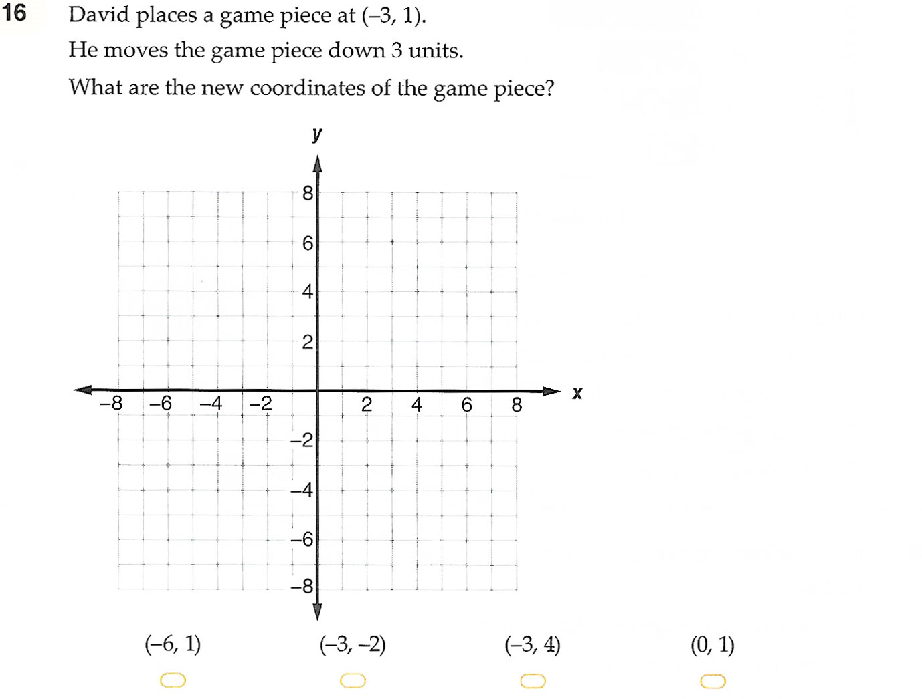
Answer = b

Slide 4
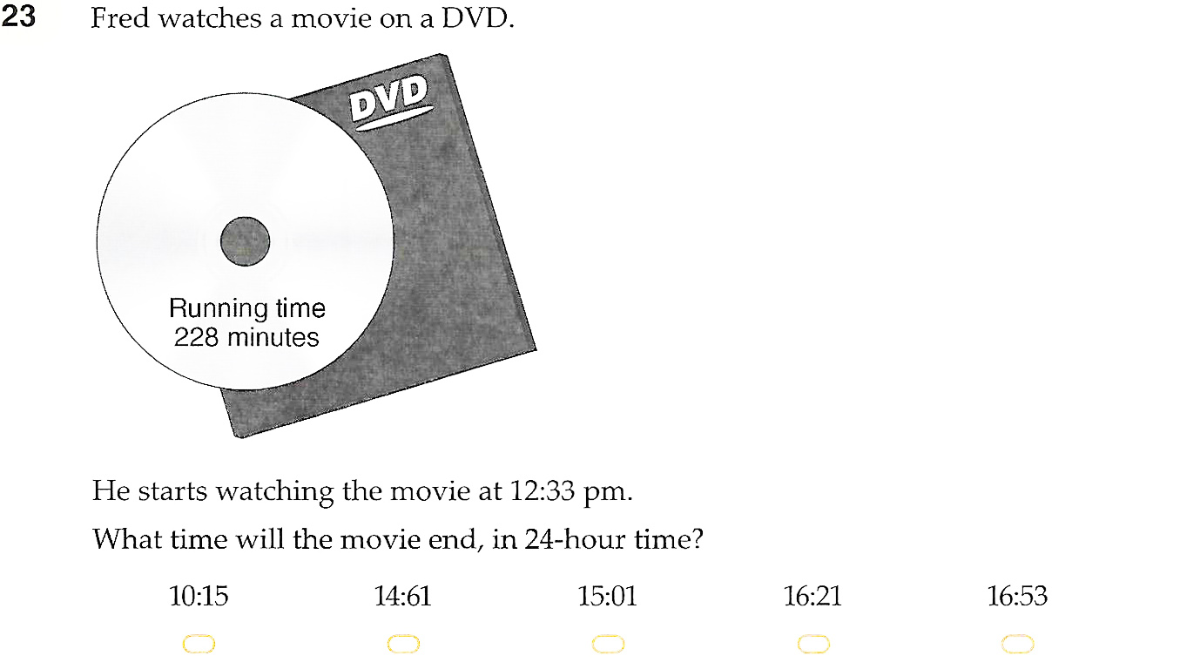
Answer = d

Slide 5
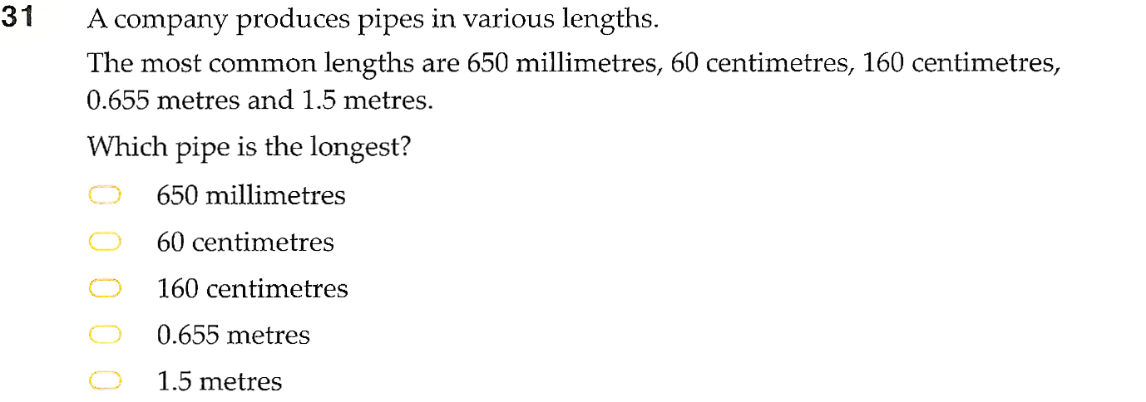
Answer = c

Slide 6
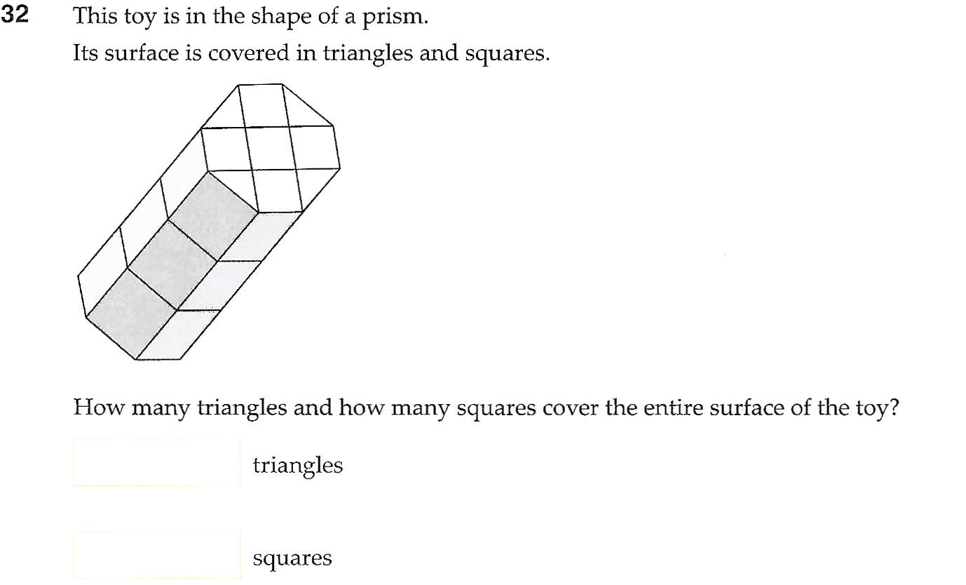
Answer: 8, 22 OR 34 (note that the 34 assumes all rectangular tiles are also squares,
22 is if only counting square tiles)

Slide 7
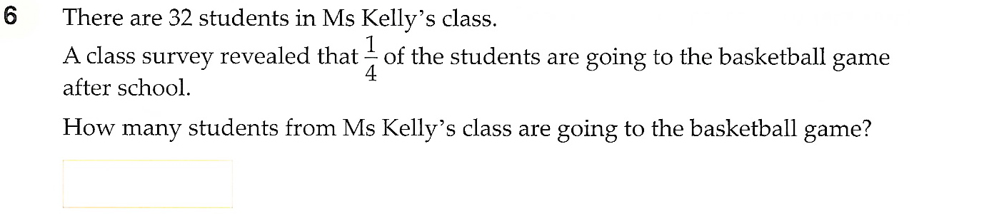
Answer: 8

Slide 8
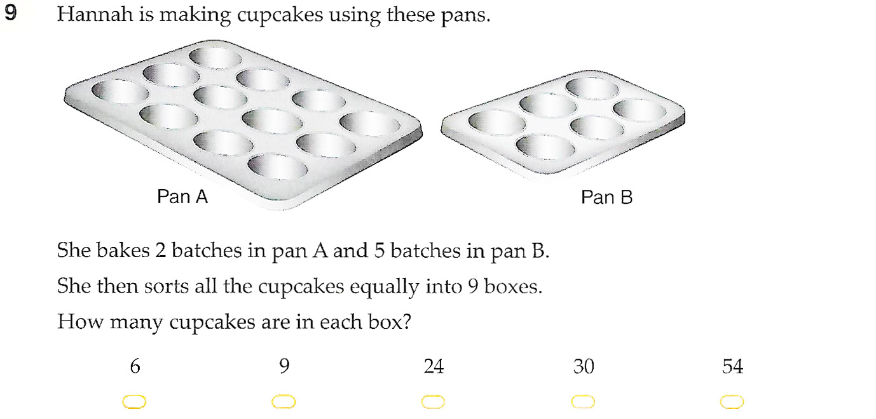
Answer: 6

Slide 9
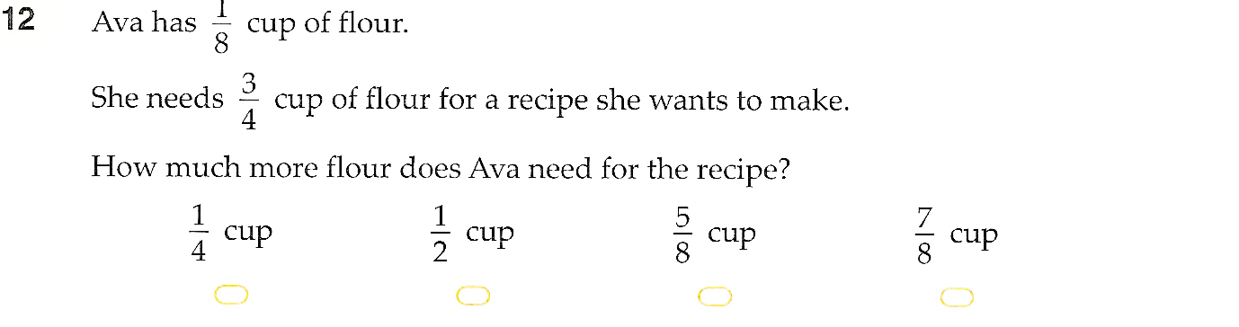
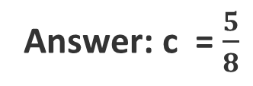
Answer: c = $\frac{5}{8}$

Slide 10
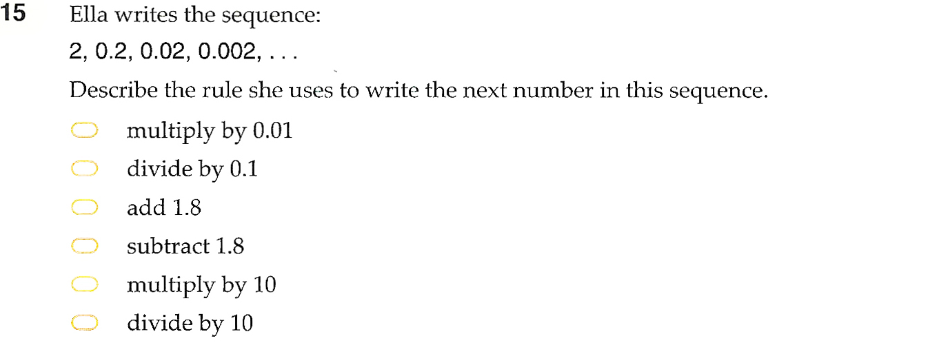
Answer: f

Slide 11
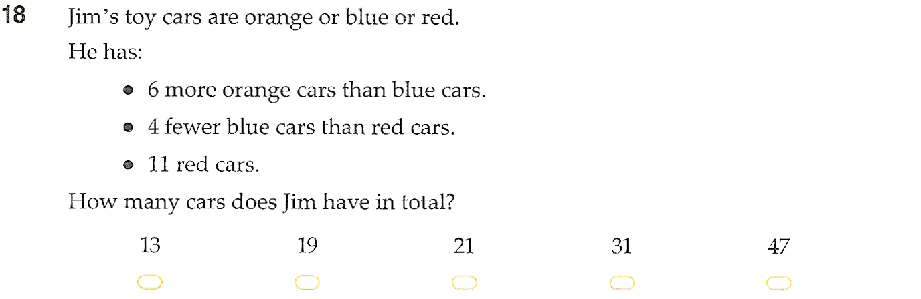
Answer: d

Slide 12
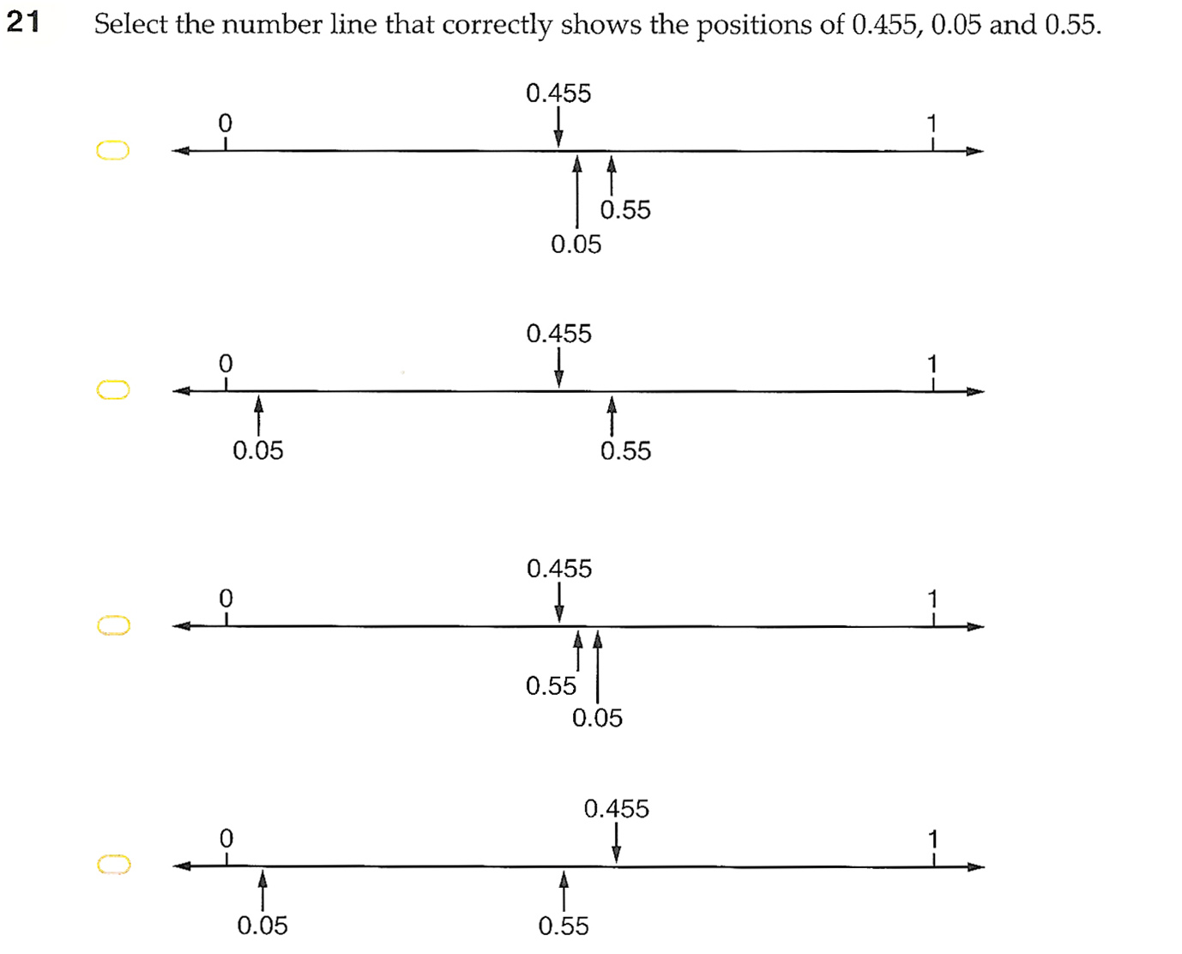
Answer: b

Slide 13
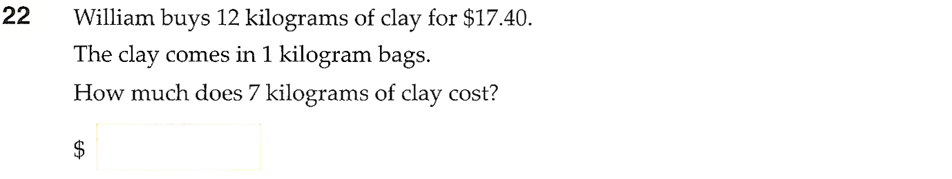
Answer: $10.15

Slide 14
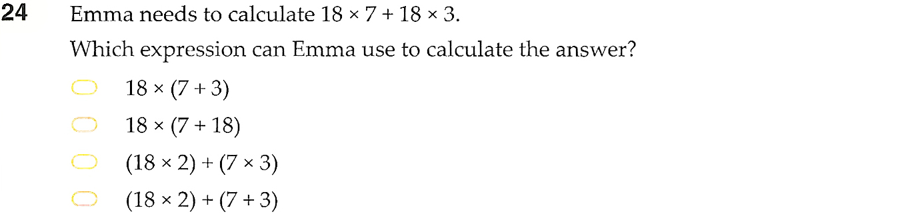
Answer: a

Slide 15
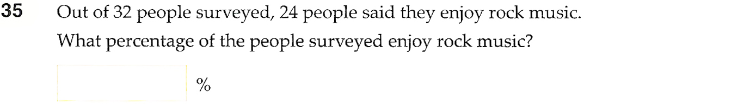
Answer: 75

Slide 16
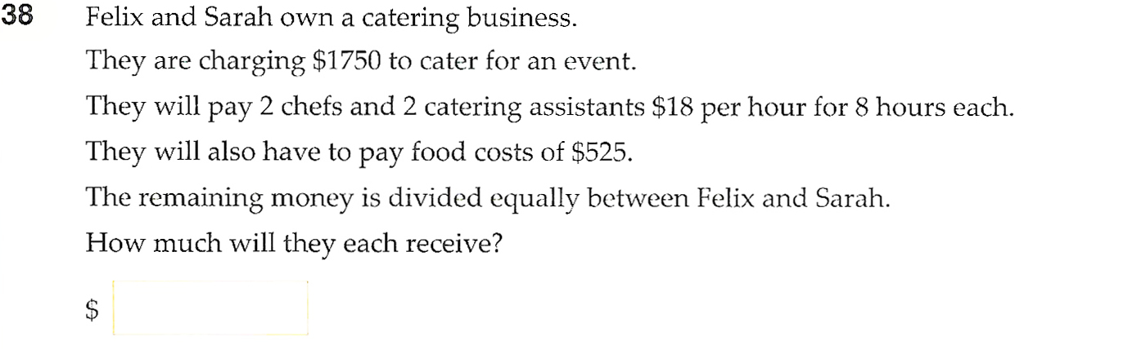
Answer: 324.50

Slide 17
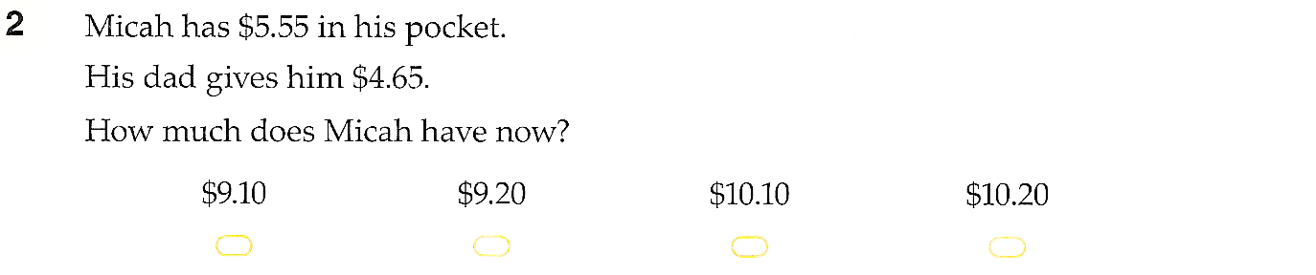
Answer: d

Slide 18
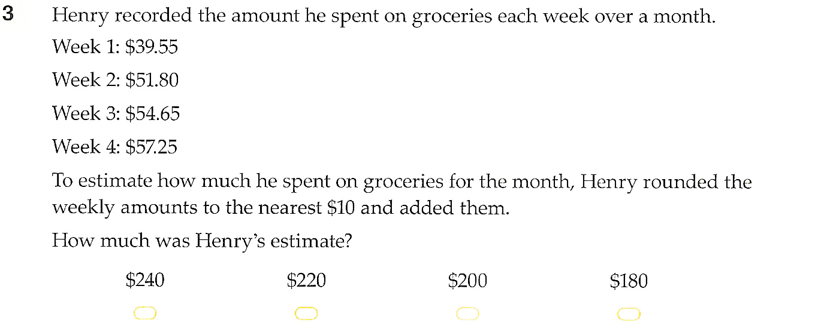
Answer: c

Slide 19
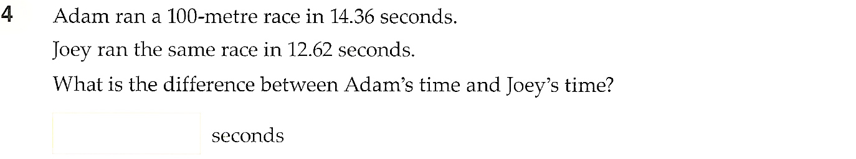
Answer:1.74

Slide 20
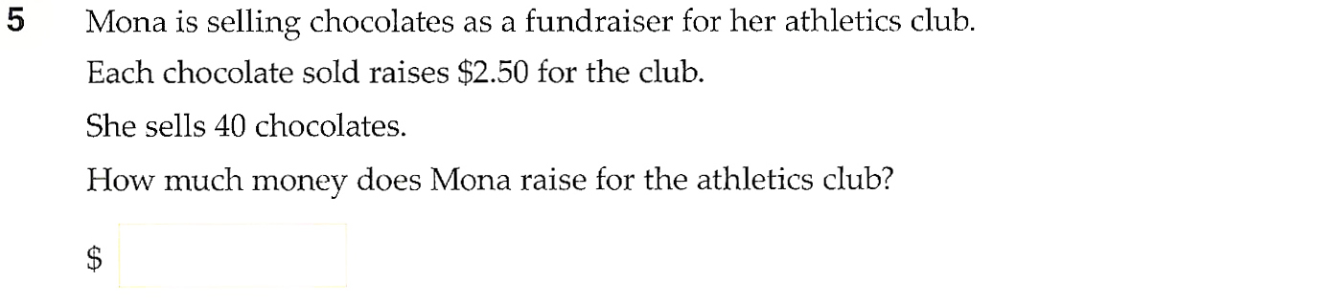
Answer:$100

Slide 21
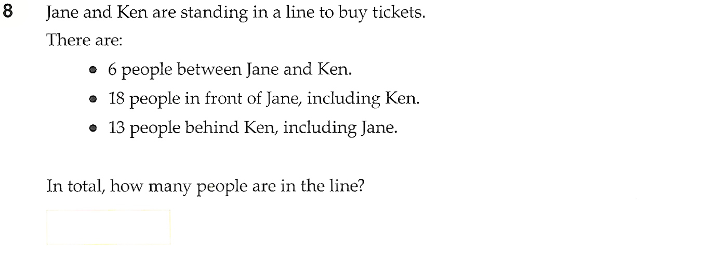
Answer:25

Slide 22
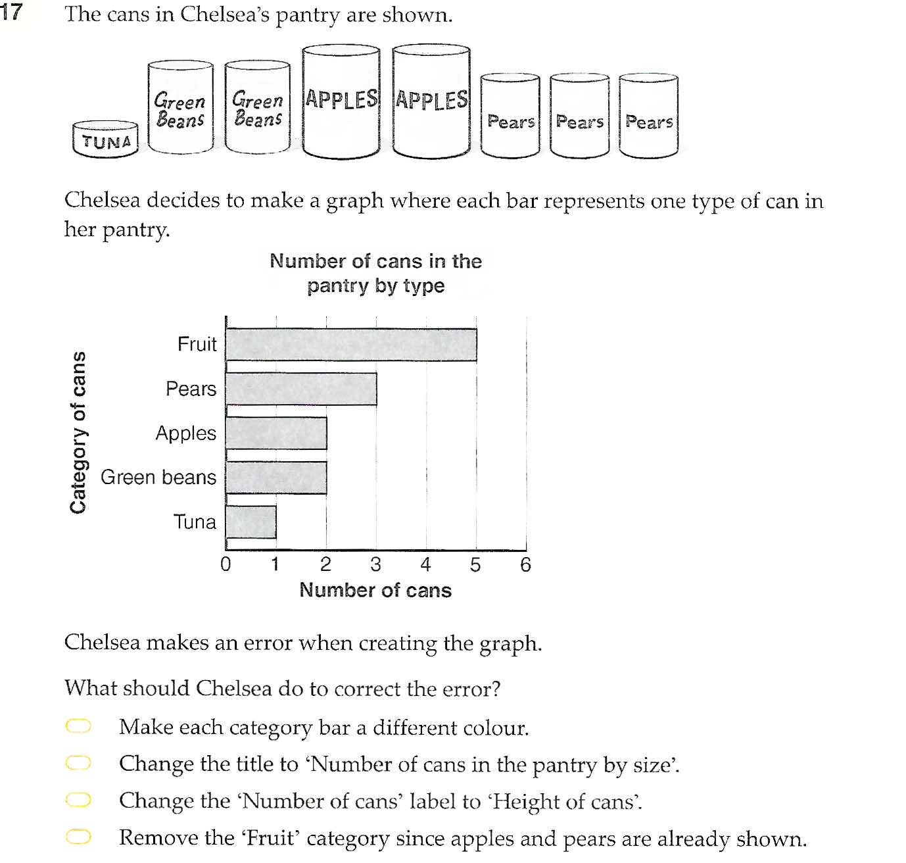
Answer:d

Slide 23
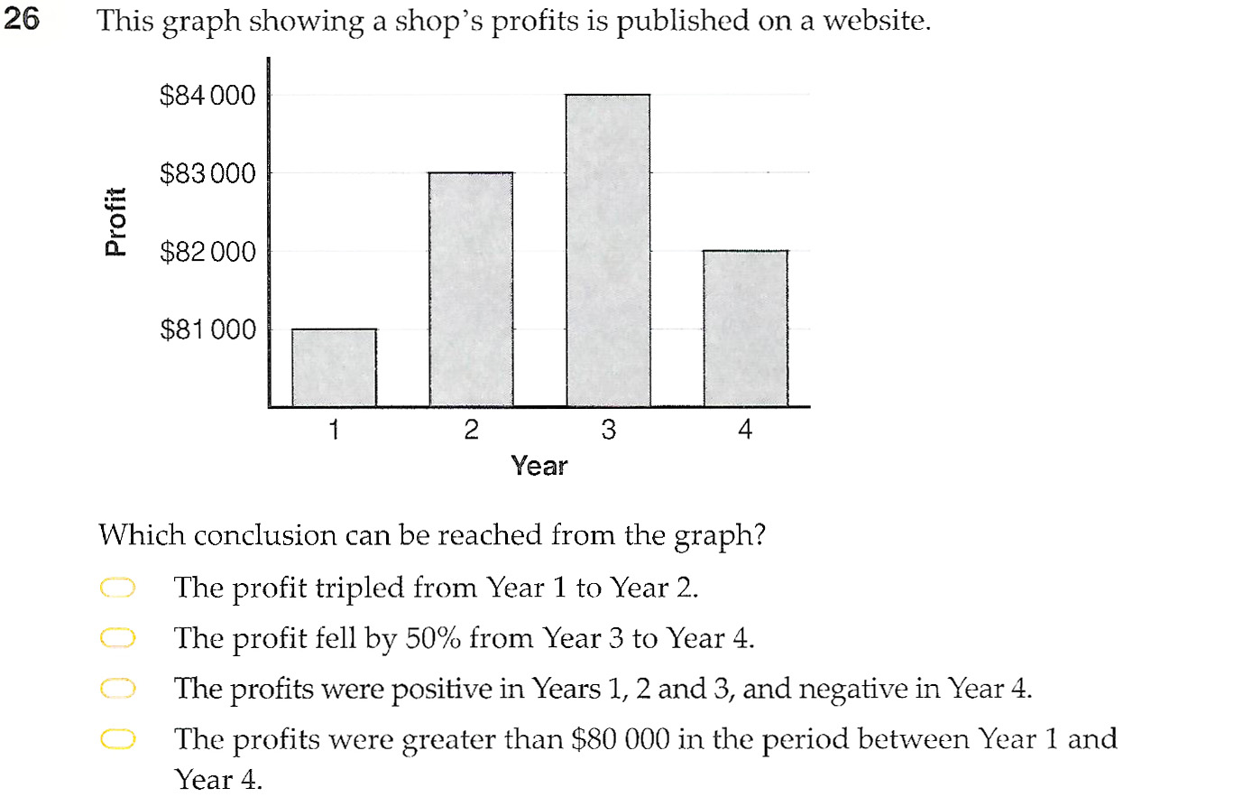
Answer:d

